Slide 1



Slide 2
If you are curious about…
How many people visit my website?
Where do my visitors live?
Do I need a mobile-friendly website?
What websites send traffic to my website?
What marketing tactics drive the most traffic to my website?
Which pages on my website are the most popular?
How many visitors have I converted into customers?
Where did my visitors come from and go on my website?
How can I improve my website's speed?
What blog content do my visitors like the most?
https://moz.com/blog/absolute-beginners-guide-to-google-analytics

Slide 3
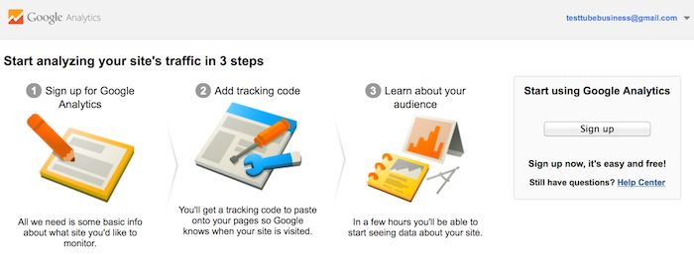
Install Google Analytics
Need a Google Analytics account

Slide 4
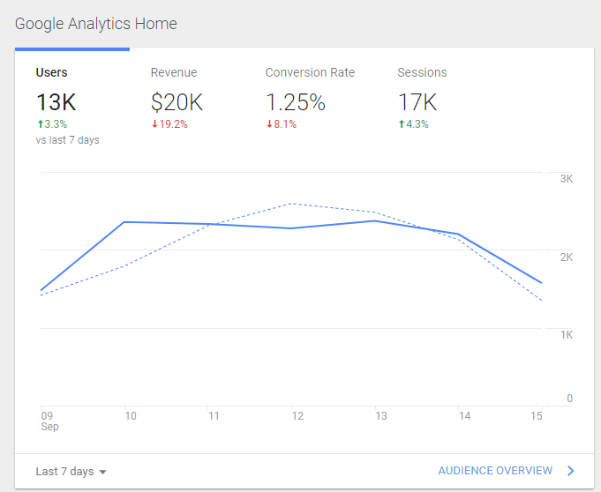

Slide 5
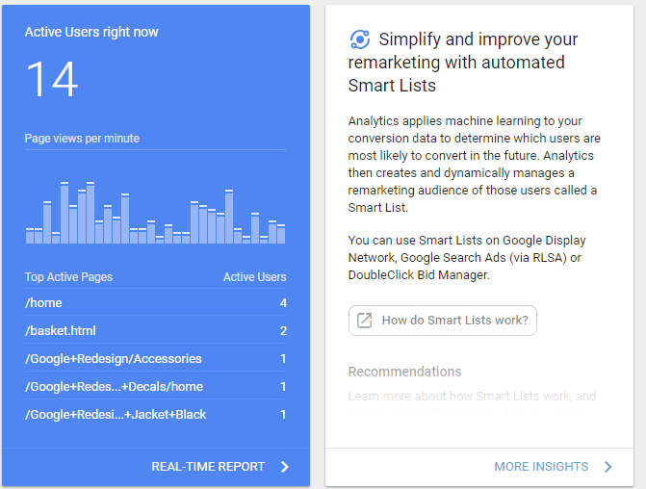

Slide 6
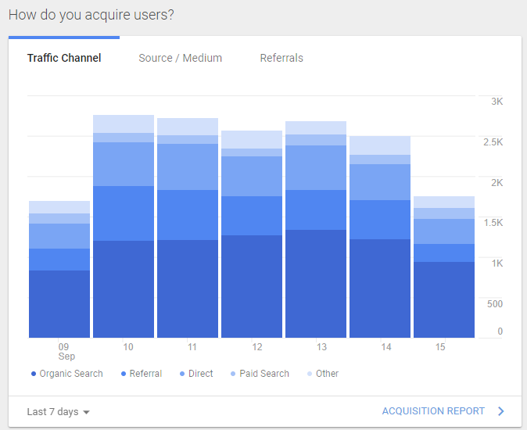

Slide 7
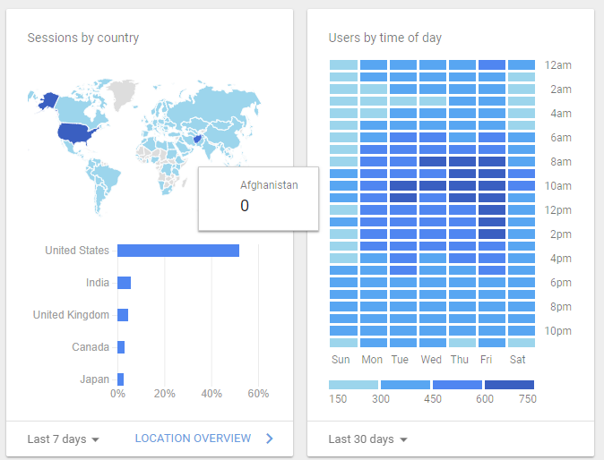

Slide 8
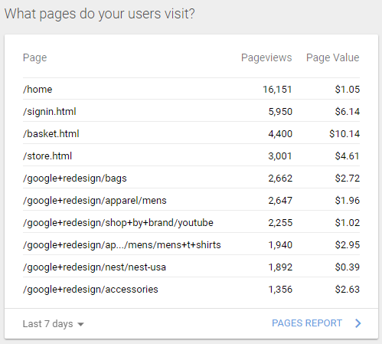

Slide 9
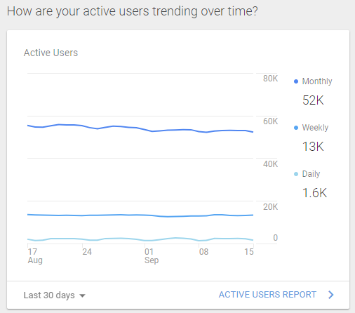

Slide 10
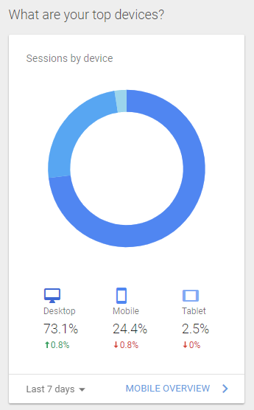

Slide 11
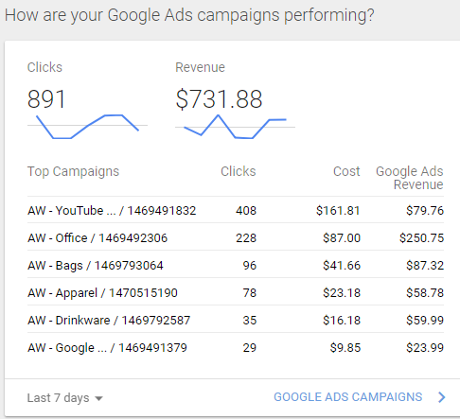

Slide 12
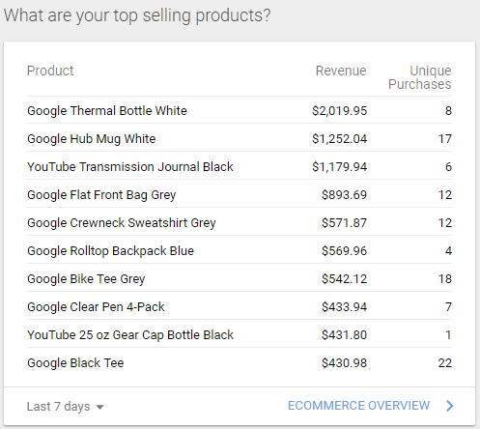

Slide 13
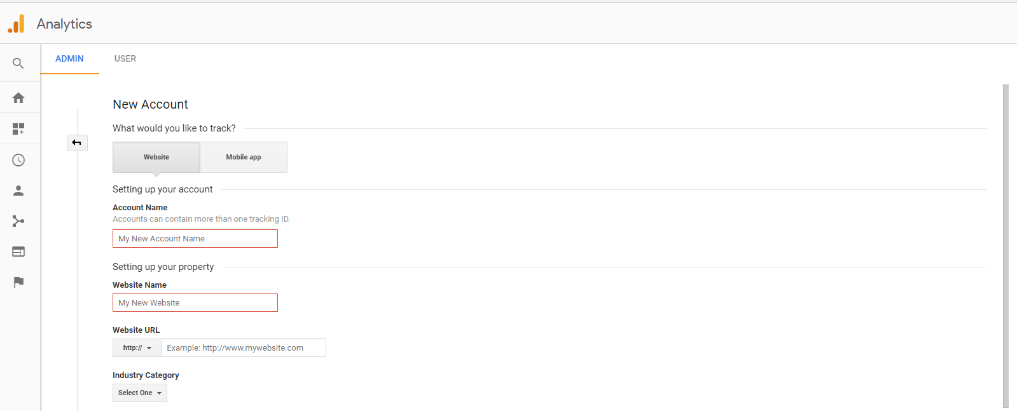
Create an new account

Slide 14
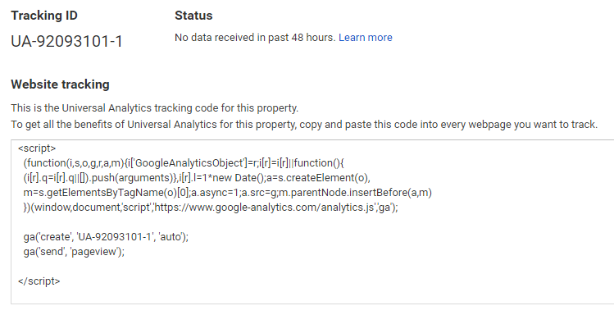
Copy and paste the script into your webpages

Slide 15
Try It Out

Slide 16
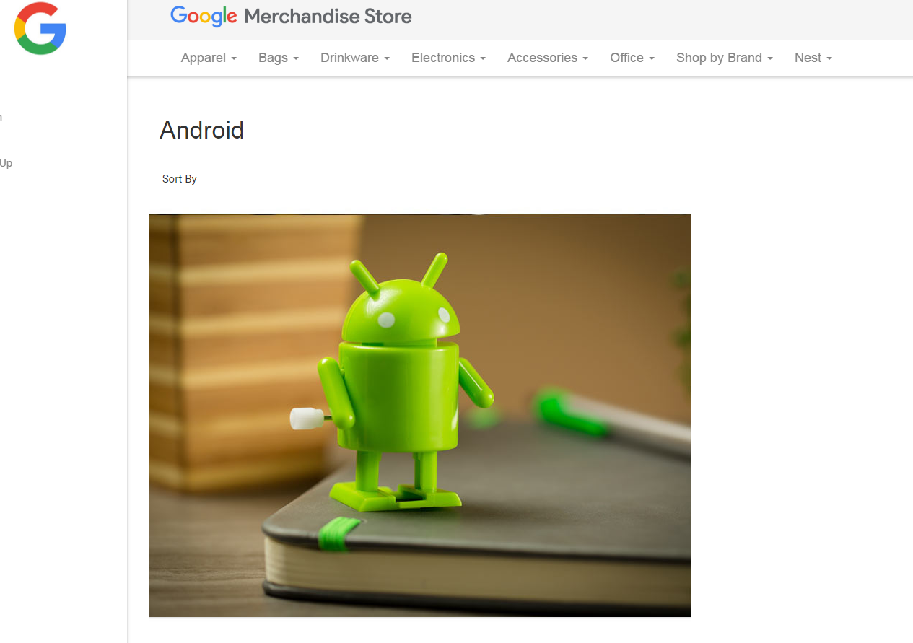
Demo account
The Google Analytics demo account is a fully functional Google Analytics account that any Google user can access.
It's a great way to look at real business data and experiment with Google Analytics features.
The data in the Google Analytics demo account is from the Google Merchandise Store, a real ecommerce store.
https://support.google.com/analytics/answer/6367342?hl=en

Slide 17
Demo Account
Information about the demo account can be found here https://support.google.com/analytics/answer/6367342?hl=en
Click this link to add the demo account to your Google Analytics: https://analytics.google.com/analytics/web/demoAccount

Slide 18
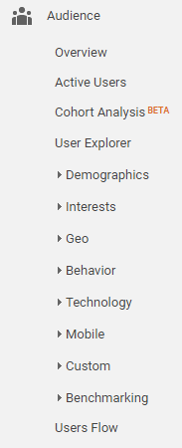
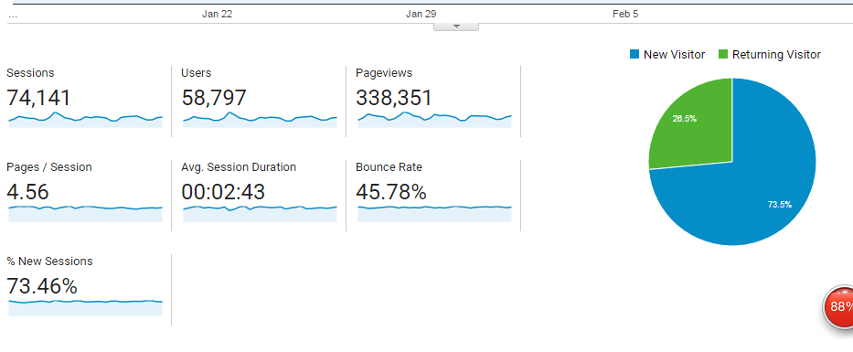
Audience

Slide 19
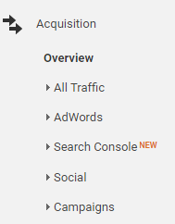
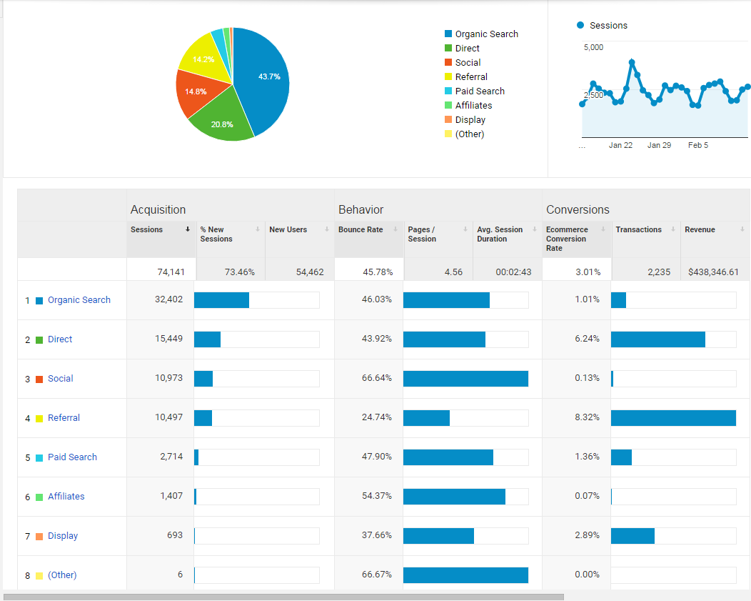
Acquisition
Search engine
URL/bookmarks
Social media

Slide 20
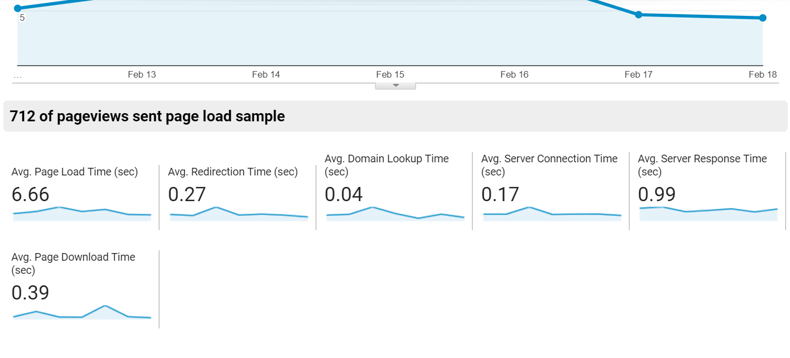
Page timings

Slide 21
demo account in your Google analytics
https://support.google.com/analytics/answer/6367342?hl=en

Slide 22
Individual assignment 4
Answer the 10 questions for individual assignment 4 on Reggienet
due 9/28

Slide 23
Reminder
Prepare for the heuristic evaluation presentation on 10/5
Individual Assignment3-Card sotring due tonight

